Slide 1


Dialysis For Technician
Dr. M.L.Patel
Additional Professor
Department of Medicine
KGMU Lucknow

Slide 2
Outline
Indications
Modalities
Apparatus
Access
Complications of dialysis access
Acute complications of dialysis

Slide 3
Indications
Pericarditis or pleuritis
Progressive uremic encephalopathy or neuropathy ( asterixis, myoclonus, seizures)
Bleeding diathesis
Fluid overload unresponsive to diuretics
Metabolic disturbances refractory to medical therapy (hyperkalemia, metabolic acidosis, hyper- calcemia , hyper- phosphatemia)
Persistent nausea/vomiting, weight loss, or malnutrition
Toxic overdose of a dialyzable drug….Dialysable substance IgG/>>>>IgM

Slide 4
Indications for RRT
Acute management of life-threatening complications of AKI:
A: Metabolic acidosis (pH less than 7.1)
E: Electrolytes -- Hyperkalemia (K >6.5 meq/L) or rapidly rising
K)
I: Ingestion -- Certain alcohol and drug intoxications
O: Refractory fluid overload
U: Uremia, ie. pericarditis, neuropathy, decline in mental status

Slide 5
Goals of Dialysis
Solute clearance
  Diffusive transport (based on countercurrent flow of blood and dialysate)
  Convective transport (solvent drag with ultrafiltration)
Fluid removal

Slide 6
Modalities
Peritoneal dialysis
Intermittent hemodialysis
Hemofiltration
Continuous renal replacement therapy
Decision of modality determined by catabolic rate, hemodynamic stability, and whether primary goal is fluid or solute removal

Slide 7
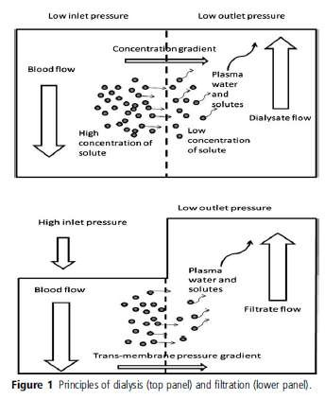
Principles of dialysis
Dialysis = diffusion = passive movement of solutes across a semi- permeable membrane down concentration gradient
  Good for small molecules
(Ultra)filtration = convection = solute + fluid removal across semi- permeable membrane down a pressure gradient (solvent drag)
  Better for removal of fluid and medium- size molecules
Faber. Nursing in Critical Care 2009; 14: 4

Slide 8
Principles of dialysis
Hemodialysis = solute passively diffuses down concentration gradient
  Dialysate flows countercurrent to blood flow.
  Urea, creatinine, K move from blood to dialysate
  Ca and bicarb move from dialysate to blood.
Hemofiltration: uses hydrostatic pressure gradient to induce filtration
/ convection plasma water + solutes across membrane.
Hemodiafiltration: combination of dialysis and filtration.
Miller's Anesthesia, 7th ed. 2009
Foot. Current Anaesthesia and Critical Care 2005; 16:321-329

Slide 9
Hemodialysis Apparatus
Dialyzer (cellulose, substituted cellulose, synthetic noncellulose membranes)
Dialysis solution (dialysate – water must remain free of Al, Cu, chloramine, bacteria, and endotoxin)
Tubing for transport of blood and dialysis solution
Machine to power and mechanically monitor the procedure (includes air monitor, proportioning system, temperature sensor, urea sensor to calculate clearance)

Slide 10
Hemodialysis Access
Acute dialysis catheter (vascular catheter, i.e. Quentin catheter)
Cuffed, tunneled dialysis catheter (Permcath)
Arteriovenous graft
Arteriovenous fistula

Slide 11
Arteriovenous Fistula
Preferred form of dialysis access
Typically end-to-side vein-to-artery anastamosis
Types
  Radiocephalic (first choice)
  Brachiocephalic (second choice)
  Brachiobasilic (third choice, requires superficialization of basilic
vein, i.e. transposition)
Lower extremity fistulae are rare

Slide 12
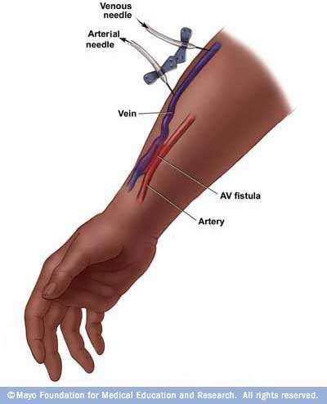
Radiocephalic AVF

Slide 13
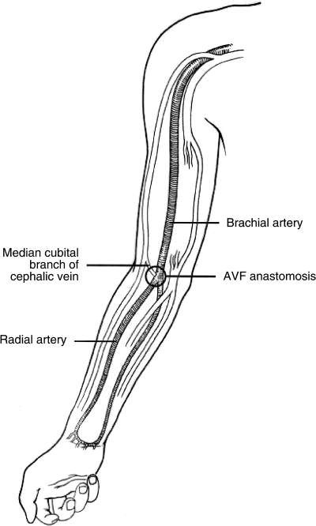
Brachiocephalic AVF

Slide 14
Arteriovenous Graft
Synthetic conduit, usually polytetrafluoroethylene , between an artery and a vein
Either straight or looped
Common sites
  Straight forearm : Radial artery to cephalic vein
  Looped forearm : brachial artery to cephalic vein
  Straight upper arm : brachial artery to axillary vein
  Looped upper arm : axillary artery to axillary vein

Slide 15
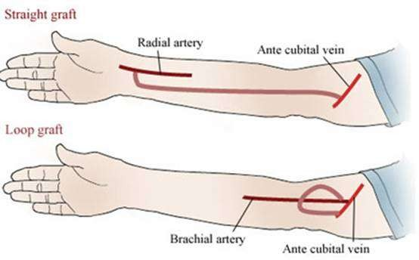
Arteriovenous Graft

Slide 16
Tunneled Cuffed Catheters
Dual lumen catheters
Most commonly placed in the internal jugular vein, exiting at the upper, anterior chest
Can also be placed in the femoral vein
Subclavian catheters should be avoided given the risk of subclavian stenosis

Slide 17
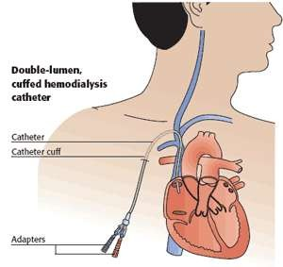
Cuffed Dialysis Catheter

Slide 18
Dialysis Access : Time to use
Graft
  Usually cannulated within weeks
  Vectra or flexine grafts can safely be cannulated after ~12 hours
Fistula
  Median period of 100 days before cannulation in the U.S. and U.K.
  Initial cannulation should be performed with small gauge needles
and low blood flow

Slide 19
Complications of AVF and AVG
Thrombosis
Infection (10% for AVG, 5% for transposed AVF, 2% for non- transposed AVF)
Seromas
Steal (6% of B-C AVF, 1% of R-C AVF)
Aneurysms and pseudoaneurysms (3% of AVF, 5% of AVG)
Venous hypertension (usually 2/2 central venous stenosis)
Heart failure (Avoid AVFs in pts with severely depressed
LVEF)
Local bleeding

Slide 20
Tunnel Cuffed Catheters
Indications
  Intermediate-duration vascular access during maturation of AVF or AVG
  Expected lifespan on dialysis of < 1 year (due to co-morbidities or on living donor transplant list)
  Medical contra-indication to permanent dialysis access (severe heart failure)
  Patients who refuse AVF or AVG after explanation of the risks of a catheter
  All other dialysis access options have been exhausted

Slide 21
Tunnel Cuffed Catheters : Complications
Infection
  Risk of bacteremia 2.3 per 1000 catheter days or 20 to 25% over the average duration of use
Dysfunction
  Defined as inability to sustain blood flow of >300 mL/min
  By this definition, 87% of catheters malfunction in their lifetime
Central venous stenosis
Mortality (may be influenced by selection bias)

Slide 22
Tunnel Cuffed Catheters : Bacteremia
Metastatic infections
 Osteomyelitis, endocarditis, septic arthritis, suppurative thrombophlebitis, or epidural abscess
Risk factors : prolonged duration of usage, previous bacteremia, recent surgery, diabetes mellitus, iron overload, immunosuppression, malnutrition

Slide 23
Tunnel Cuffed Catheters : Bacteremia
Clinical manifestations
  Fevers or chills in catheter-dependent dialysis patients associated with positive blood cultures in 60 to 80%
  Less commonly : hypotension, altered mental status, catheter dysfunction, hypothermia, and acidosis

Slide 24
Tunnel Cuffed Catheters : Bacteremia
Empiric Treatment
  Vancomycin (load with 15-20 mg/kg and then 500-1000 mg after each HD session) plus either gentamicin (load with 2 mg/kg and then 1 mg/kg after each HD session) or ceftazidime (2 grams after each HD session)
  Avoid prolonged use of an aminoglycoside given the risk of ototoxicity with vestibular dysfunction

Slide 25
Tunnel Cuffed Catheters : Bacteremia
Duration
  Catheter removal and replacement, early resolution of symptoms, blood cultures quickly negative : 2 to 3 weeks
  Uncomplicated S. aureus infection : 4 weeks
  Metastatic infection or persistently positive blood cultures : minimum 6 weeks
  Osteomyelitis : 6 to 8 weeks

Slide 26
Acute Complications of Dialysis
Hypotension (25-55%)
 Cramps (5-20%)
Nausea and vomiting (5-15%)
Headache (5%)
Chest pain (2-5%)
Back pain (2-5%)
Itching (5%)
Fever and chills (<1%)

Slide 27
Acute Complications of Dialysis
Chest pain
  Can be associated with hypotension and dialysis disequilibrium syndrome
  Always consider angina, hemolysis, and (rarely) air embolism
  Consider pulmonary embolism if recent manipulation of thrombus and/or occlusion of the dialysis access

Slide 28
Acute Complications of Dialysis
Hemolysis
  Suggestive findings include port wine appearance of the blood in the venous line, a falling hematocrit, or complaints of chest pain, SOB, and/or back pain
  Usually due to dialysis solution problems, including overheating, hypotonicity, and contamination with formaldehyde, bleach, chloramine, or nitrates in the water, or copper in the dialysis tubing
  Treatment includes discontinuation of dialysis without blood return to the patient, and evaluation for hyperkalemia with medical treatment as necessary

Slide 29
Acute Complications of Dialysis
Arrhythmias
  Common during, and between, dialysis treatments
  Controversial whether due to disturbances in plasma potassium
  Treatment is similar to the non-dialysis population, except for medication dosing adjustments

Slide 30
Thank you
 Blood and Dialysate have to run opposite to achieve optimum clearance …..Fluid and Solute
 Learning is always unidirectional …..Institute to Individual.

